Slide 1
Telemedicine Billing: Past, Present, and Future
Presenter: Jim Tudor, CPC, PCA

Slide 2
About HCN
With over 25 years of experience in healthcare regulation and compliance, Healthcare Compliance Network (HCN) is a leading provider of education, training, auditing and compliance products and services. HCN facilitates a streamlined approach to achieving regulatory compliance for healthcare organizations of all sizes. With an emphasis on physician practices, HCN’s Hi-Tech Hi-Touch approach can be tailored to provide both on site services as well as web-based applications.
Notes:
Need for HIPAA compliant platform once PHE is over.

Slide 3
Presenter
Jim Tudor, CPC, PCA
Director, coding and billing compliance
Jim has over 30 years of experience in the industry and has designed and administered billing compliance audit programs for physician provider organizations, hospitals, and medical offices. He has extensive experience within virtually all specialties, and has served as a coder, auditor, educator, manager, and director. Jim also plays a key role in our payer validation audit initiatives, assisting clients with appeals and providing expert feedback to legal counsel.

Slide 4
Disclaimer
Information presented herein represents current CMS and CPT guidelines at the time of this presentation
Payer specific nuances apply to many telehealth services.

Slide 5
Traditional Application of Telehealth
To provide access of care to individuals who reside in Health Professional Shortage Areas (HPSA)
Common applications include primary care, teleconsultations, behavioral health, chronic care management
Originating site (patient location) is usually a clinic or hospital, distant site (provider location) typically in provider office.
Payment split in two: facility and provider
Notes:
More than 55 million live in HPSAs, and 77% of the nations rural counties designated as such.

Slide 6
“COVID-19” Application of Telehealth
1135 Waiver Authority / Coronavirus Preparedness and Response Supplemental Appropriations Act
Allows for telehealth services to be furnished to patients in in all areas of the country in all settings.
Includes services provided in any healthcare facility or in patients home.
These visits are considered the same as in-person visits and are paid at the same rate as regular, in-person visits.
Notes:
Effective 3/6

Slide 7
“COVID-19” Application of Telehealth
A rocky start…….
Q: What about patients who don’t have/refuse to use video technology or internet?
Q: Why isn’t my CPT code on the list of allowed telehealth services?
Q: How do we document?
Q: Do all payers follow Medicare?
Q: What place of service code do we use?
Q: How long will this last?

Slide 8
“COVID-19” Application of Telehealth
Q: What about patients who don’t have/refuse to use video technology or internet?
A: CMS began paying phone call codes per 3/31/20 directive
Q: Why isn’t my CPT code on the list of allowed telehealth services?
A: The CMS list of telehealth-approved codes includes only those services for which standard of care can be met.
Q: How do we document?
A: The same way you normally would, except to include: type of service (e.g. audio/video, phone call), provider location, patient location, and names of all persons participating in the telehealth service and their role in the encounter
Q: Do all payers follow Medicare rules?
A: Not necessarily. Virtually all payers cover telehealth to some extent, but may apply different rules (unless contra-indicated by state directive)
Q: What place of service code do we use?
A: Same one you usually use (e.g. POS 11 for physician office). Some require POS 02 (telehealth encounter)
Q: How long will this last?
A: Until the PHE is declared over. BREAKING NEWS: the PHE has just been extended for another 90 days, now set to expire 10/23/2020

Slide 9
Audio/Video
Virtual Check In
Phone Calls
E-Visits
Virtual Consults
Remote Physiologic Monitoring
Store & Forward

Slide 10
CMS Guidelines – Coding & Documentation
“COVID-19” Application of Telehealth
Audio and video
Most E/M codes are on the approved list
E/M services: throughout the duration of the PHE, the provider may use either medical decision making or time. No need to meet other requirements (HPI, ROS, exam, etc)
Time may include the total intraservice time (e.g. ‘before, during and after’ work) devoted to patient on same day
Bill the most appropriate code along with modifier 95.
POS is the same as the place of service you normally do business from.
Audio only
Do not bill a ‘traditional’ E/M code to Medicare – they want the phone call codes
99441: 5-10 min, 99442: 11-20 min, 99443: 21 min or greater
Payment aligns with 99212-99214
Must document time!
Above guidelines apply to both new or established patients
Notes:
MDM / time provision similar to 2021 guidelines

Slide 11
“COVID-19” Application of Telehealth
More About Phone Calls……
You cannot bill these codes if any of the following conditions apply:
Subject matter is related to a previous E/M encounter within past 7 days
Subject matter is related to a preplanned E/M encounter to occur within next 24 hours
If the call results in the scheduling of an E/M encounter within next 24 hours
Separate codes for other providers
Time | MD and NPP | PT, OT, Speech, Clinical Psychologist
5-10 minutes | 99441 | 98966
11-20 minutes | 99442 | 98967
21 or more minutes | 99443 | 98968

Slide 12
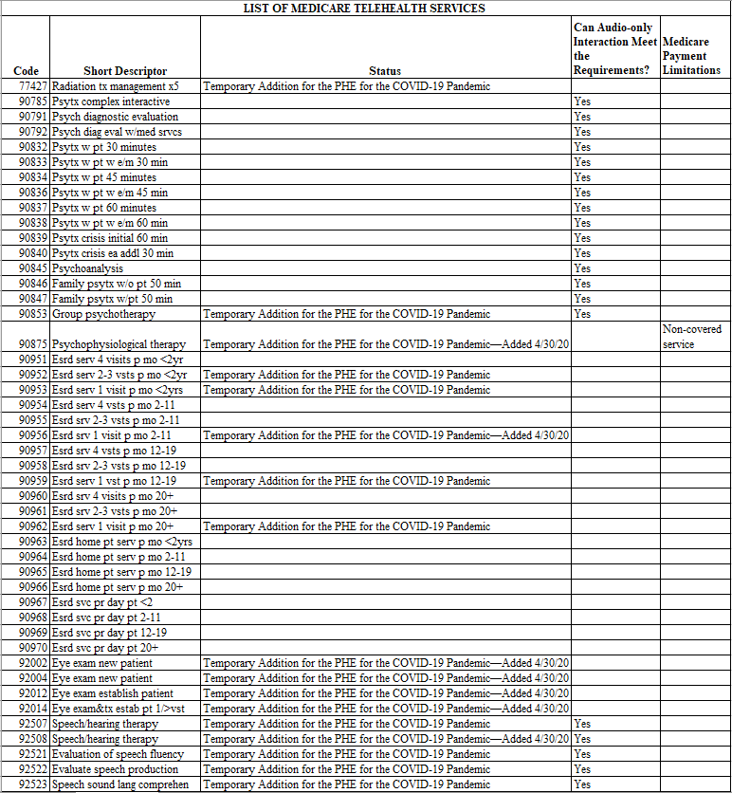
CMS Code List – Telehealth Services
“COVID-19” Application of Telehealth
https://www.cms.gov/Medicare/Medicare-General-Information/Telehealth/Telehealth-Codes
Notes:
Snapshot is not an all inclusive list

Slide 13
Other Virtual Services
Notes:
7/24 concept

Slide 14
Virtual Check In / Store & Forward
Intent of Virtual Check In is to avoid unnecessary trips to the office
Store & Forward – provider review of previously recorded images and video
Patient must verbally consent
Only for providers who can bill E/M codes
“7/24” concept applies
G2012 - Brief communication technology-based service, e.g. virtual check-in, by a physician or other qualified health care professional who can report evaluation and management services, provided to an established patient, not originating from a related e/m service provided within the previous 7 days nor leading to an e/m service or procedure within the next 24 hours or soonest available appointment; 5-10 minutes of medical discussion
G2010 - Remote evaluation of recorded video and/or images submitted by an established patient (e.g., store and forward), including interpretation with follow-up with the patient within 24 business hours, not originating from a related e/m service provided within the previous 7 days nor leading to an e/m service or procedure within the next 24 hours or soonest available appointment

Slide 15
E-Visits
E-visits refer to communications with providers via online patient portals, or via secured email.
Not to be used for scheduling appointments or reviewing test results
These are 7 day global codes – you bill for the aggregate amount of time spent over the course of a week
Separate codes for PT/OT, speech pathologist, clinical psychologist.
Time spent over 7 day period | MD or NPP | Other (PT, OT, Speech, Clinical Psychologist
5-10 minutes | 99421 | G2061
11-20 minutes | 99422 | G2062
21 or more minutes | 99423 | G2063
Notes:
New code for 2020

Slide 16
Virtual Consultations
Inpatient or Outpatient Without Patient Face to Face Encounter
Inpatient or ED Only With Patient Face to Face Encounter
99446 5-10 minutes of medical consultative discussion and review, with verbal and written report
99447 – 11-20 minutes of medical consultative discussion and review, with verbal and written report
99448 - 21-30 minutes of medical consultative discussion and review, with verbal and written report
99449 – 31 or more minutes of medical consultative discussion and review, with verbal and written report
99451 - 5 minutes or more of medical consultative time with written report ONLY
G0425 – initial, 30 min via telehealth
G0426 – initial, 50 min via telehealth
G0427 – initial, 70 min via telehealth
G0406 – follow up, 15 min via telehealth
G0407 – follow up, 25 min via telehealth
G0408 - follow up, 35 min via telehealth
PCP / Other Referring Source
99452-Interprofessional telephone/Internet/electronic health record referral service(s) provided by a treating/requesting physician or other qualified health care professional, 16-30 minutes
Notes:
Quick overview.

Slide 17
Remote Physiologic Monitoring (RPM)
99453: Remote monitoring of physiologic parameter(s) (eg, weight, blood pressure, pulse oximetry, respiratory flow rate), initial; set-up and patient education on use of equipment
99454: Remote monitoring of physiologic parameter(s) (eg, weight, blood pressure, pulse oximetry, respiratory flow rate), initial; device(s) supply with daily recording(s) or programmed alert(s) transmission, each 30 days
99091: Collection and interpretation of physiologic data (eg, ECG, blood pressure, glucose monitoring) digitally stored and/or transmitted by the patient and/or caregiver to the physician or other qualified health care professional, qualified by education, training, licensure/regulation (when applicable) requiring a minimum of 30 minutes of time, each 30 days
99473: Self-measured blood pressure using a device validated for clinical accuracy; patient education/training and device calibration
99474: Self-measured blood pressure using a device validated for clinical accuracy; separate self-measurements of two readings one minute apart, twice daily over a 30-day period (minimum of 12 readings), collection of data reported by the patient and/or caregiver to the physician or other qualified health care professional, with report of average systolic and diastolic pressures and subsequent communication of a treatment plan to the patient
99457: Remote physiologic monitoring treatment management services, clinical staff/physician/other qualified health care professional time in a calendar month requiring interactive communication with the patient/caregiver during the month; first 20 minutes
99458: Remote physiologic monitoring treatment management services, clinical staff/physician/other qualified health care professional time in a calendar month requiring interactive communication with the patient/caregiver during the month; each additional 20 minutes (List separately in addition to code for primary procedure)

Slide 18
Post COVID
Notes:
7/24 concept

Slide 19
“I can’t imagine going back. People recognize the value of this, so it seems like it would not be a good thing to force our beneficiaries to go back to in-person visits”. Seema Verma, testifying before the Senate Finance Committee, 6/9/2020.

Slide 20
Post-COVID Telemedicine
Likely to remain:
Rural telemedicine
Virtual check in
Store & forward
E-visits
Virtual consults
Likely to remain with modifications:
E/M and other CPT codes by audio/video
Phone calls

Slide 21
Post-COVID Telemedicine
Considerations:
What if individual states continue their own PHE after the federal PHE expires?
New medical policies: standard of care, frequency limitations, place of service
Impacts on risk adjustment, value-based care
Other payers

Slide 22
jtudor@hcompliance.com James M. Tudor, CPC, PCA Director Billing Compliance HealthCare Compliance Network (HCN) 978-763-8119 ext 805
THANK YOU!

