Slide 1
Developing An Internal COVID-19 Contact Tracing Program

Slide 2
About the Presenter
Brian Ramos, MBA, CMPE
Brian Ramos serves as Chief Operating Officer of Capital Anesthesia Partners, an outpatient anesthesia practice and consulting company headquartered in Washington, DC with practice locations and clients throughout the country. Prior to joining CAP, Mr. Ramos held management positions in national anesthesia management consulting firms, academic medical centers, independent ASCs and large multi-site private practice physician groups.
Mr. Ramos earned a BA in Mathematics from Boston College and a MBA from Fitchburg State University. He is a Certified Medical Practice Executive of the American College of Medical Practice Executives. Additionally, Mr. Ramos is President & Chairman of the Board of Directors of the Maryland Medical Group Management Association and treasurer of the Maryland Patient Care & Access Coalition.

Slide 3
Abstract
With a second wave of COVID-19 outbreak looming, effective contact tracing is being touted as the only way for you to isolate the source of infection and avoid having your doors shut by state officials.
Here are just a few of the practical, easy-to-implement COVID-19 contact tracing strategies that you’ll receive by attending this online training session:
Use contact tracing to bolster patient confidence to come back to your office
Communicate mandatory self-quarantine guidelines for COVID-19 exposed staff
Implement effectively timed follow up with patients who were potentially exposed
Pin down when and if you are required to report test results to your public health department
Implement timed follow up with patients to monitor them for new symptoms

Slide 4
Unprecedented Times
Notes:
Thank you for allowing me to speak with you for the next hour. I don’t need to tell you, that we are living in unprecedented times. A lot of the webinars that I’ve attended in the last few months have focused on the immediate impact of coronavirus to the medical industry. Then, they started to focus on how to restart your practice and estimate your new patient volume, right-size your staff and schedules and provider templates and understand the financial impact of the virus. While these issues are critical and have been tremendously helpful, I believe it is also important to think about how to demonstrate to patients and staff alike that your practice is a safe environment in which to receive care and work. But first, a little background to set the stage for what we’re going to discuss today:

Slide 5
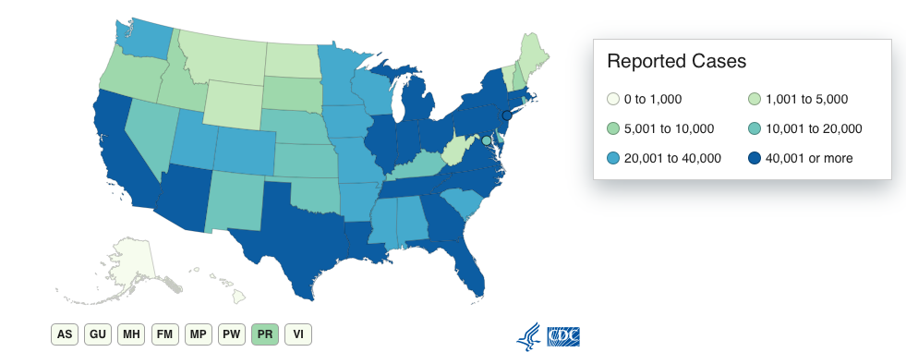
COVID-19 Data
Cases | 2,624,873
Deaths | 127,299
https://www.cdc.gov/coronavirus/2019-ncov/cases-updates/cases-in-us.html
as of 7/1/2020
Notes:
As of yesterday, there were nearly 2.6 million cases in the US and over 127,000 deaths.

Slide 6
Healthcare Impact
Notes:
In order to slow the spread of the disease, most states shut down for as many as three months, limiting travel and business to essential services only. No sector of the US economy was spared with healthcare, as you know, having been significantly impacted. In fact, (NEXT SLIDE)

Slide 7
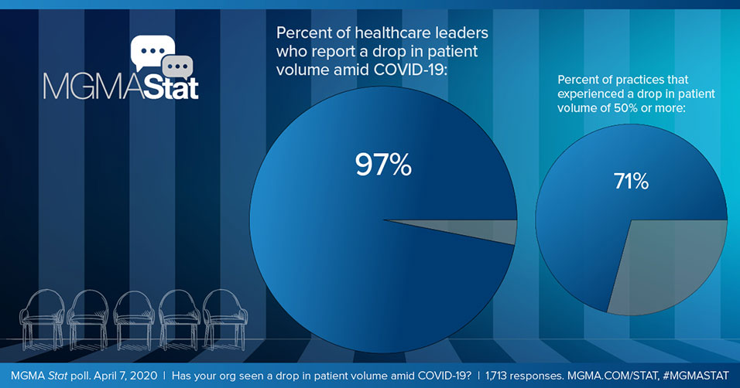
Healthcare Impact
Expected 50-80% drop in revenue associated with those visits resulting in furloughs, layoffs of staff and even closing offices.
https://www.mgma.com/data/data-stories/staying-afloat-as-patient-volumes-and-revenues-dec
Notes:
According to a recent MGMA Stat poll, 97% of healthcare leaders reported a drop in patient volume with 71% of practices experiencing a reduction of 50% or more!!!
1. All elective surgeries and procedures – cancelled.
2. Medical offices were closed
3. We were limited to emergent/urgent and pandemic related services, only. And practices were forced to use telehealth visits, almost exclusively, where applicable.
And, practices expected a 50-80% drop in revenue due to furloughs, layoffs and even closing some practice locations. Revenue is not expected to resume to pre-COVID19 levels for six to twelve months, depending on specialty.

Slide 8
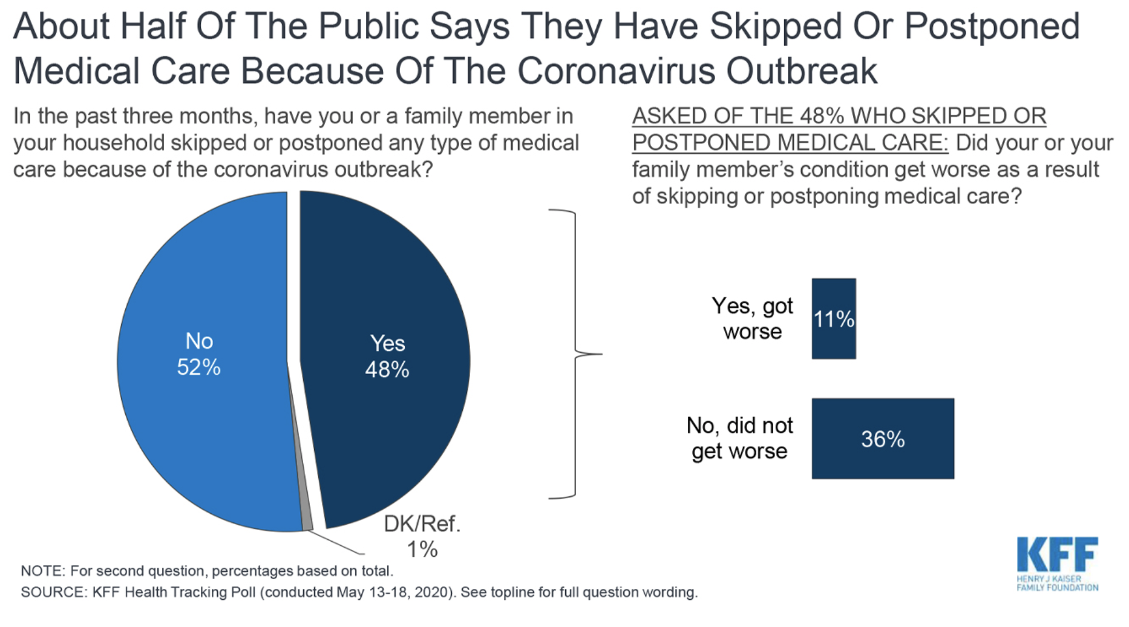
Healthcare Impact
https://khn.org/news/nearly-half-of-americans-delayed-medical-care-due-to-pandemic/
Notes:
What’s worse is that according to Kaiser Health News, nearly half of all Americans delayed medical care due to the pandemic with 11% of those reporting that their condition worsened.

Slide 9
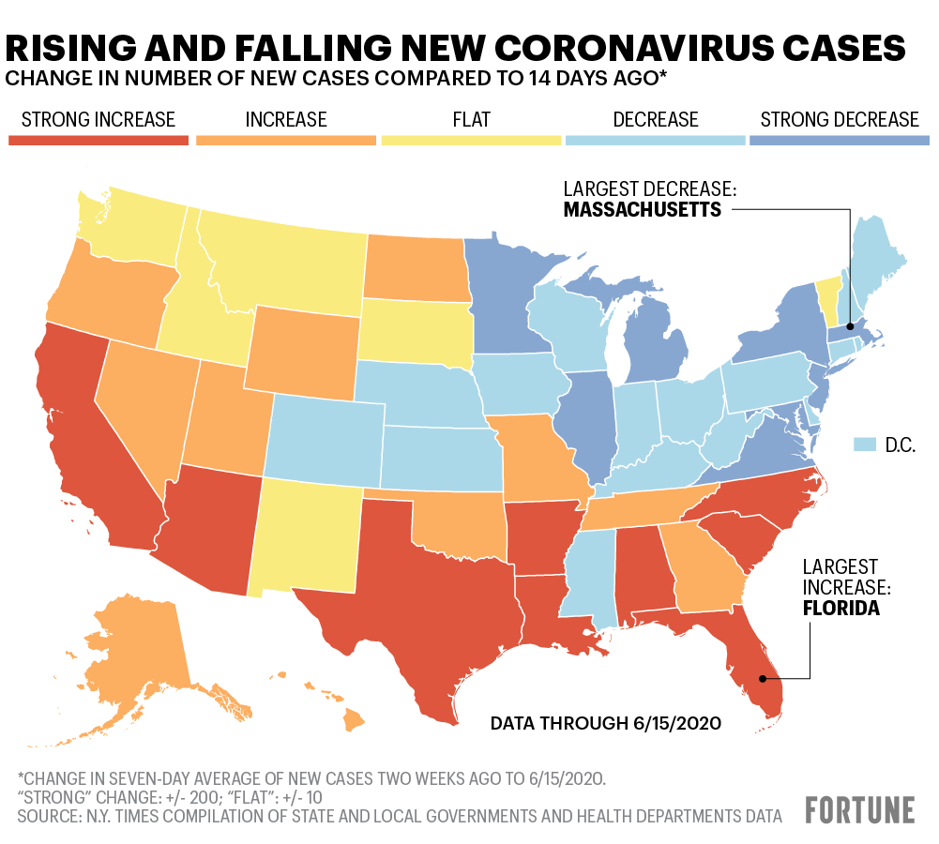
States Reopening
Notes:
Now as states begin to re-open and cases begin to rise due to increased opportunity for exposure, government and business are trying to figure out how to open safely – for both their customers and employees – while trying to understand the potential timing and impact of a second wave.

Slide 10
Consumer Confidence
Sage Growth Partners / Blackbook Research
of consumers surveyed report feeling unsafe going to their doctor’s office
33%
http://go.sage-growth.com/covid-19-market-report
Notes:
Complicating matters, however, is that patients are anxious about seeking healthcare. If you attended our recent Marketing Roadmap webinar presented by Cara Reymann of PE Practice Solutions and Capital Digestive Care, you know that 33% of consumers surveyed by Safe Growth Partners reported that they feel unsafe causing them to further delay or avoid care for chronic illness or injury. What this means is that the process of re-opening is much more complicated and will take longer than we think.

Slide 11
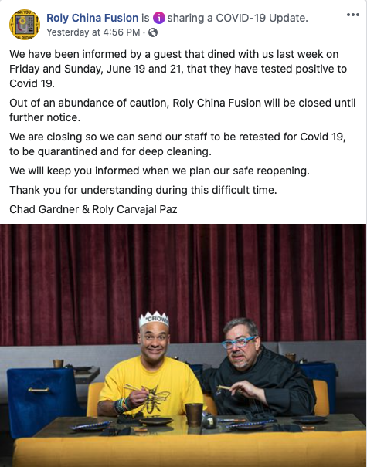
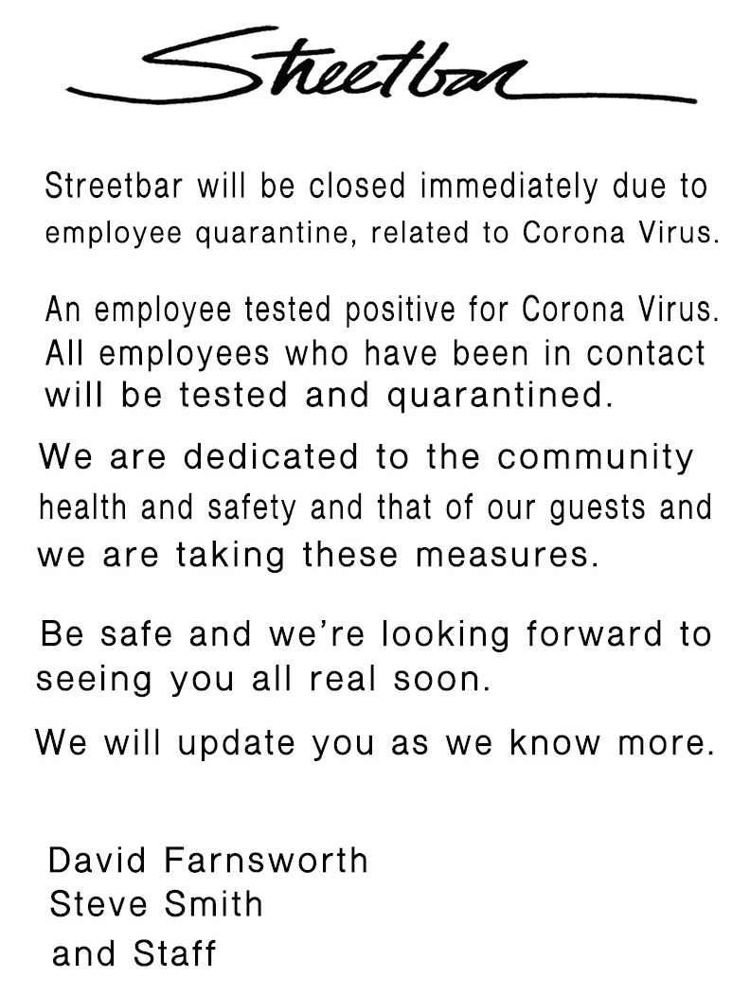
Consumer Confidence
Some businesses are beginning to shut down AGAIN
Notes:
As cases begin to rise throughout the country, we’re already starting to see businesses close down AGAIN, directly as a result of employees or customers testing positive for COVID19. Here are just four examples that occurred with 24 hours this past weekend in Palm Springs, CA where I have been working during the pandemic. And, California’s governor, Gavin Newsom, just announced new stay-at-home restrictions ahead of this weekend’s Fourth of July holiday.

Slide 12
Action Needed
Notes:
But, we can influence patient sentiment – and build trust – through our practice’s communication strategies and the actions that we take to safeguard them, to the best of our ability, while they are in your care.

Slide 13
Internal COVID-19 Contact Tracer
Notes:
So, let’s talk about how you can build a COVID19 internal contact tracing program. We’ll discuss what it looks like, how to build it, and what reporting requirements you might have.

Slide 14
What?
Contact Tracing
Process of identifying individuals who were potentially exposed to known infected individuals
Collect additional information from and test those subjects
Continue tracing to end of exposures
Public Health Goals
To interrupt ongoing transmission and reduce spread
To alert contacts to the possibility of infection
Offer diagnosis, counseling and treatment
If treatable, help prevent reinfection
To learn about the epidemiology
Notes:
Contact tracing is exactly what it sounds like it should be, the public health process of identification of persons who may have come into contact with an infected person and subsequently collecting further information about these contacts. By tracing the contacts of infected individuals, testing them for infection, treating the infected and tracing their contacts in turn, public health aims to reduce infections in the population.
Contact tracing isn’t a new process and has been used for outbreaks of tuberculosis, vaccine-preventable infections like measles, sexually transmitted infections (including HIV), blood-borne infections, and novel infections such as H1N1 and SARS-CoV and COVID-10
The goals of contact tracing are to identify, treat and reduce the rate of infection while learning more about the epidemiology of the disease.

Slide 15
Practice Goals
1
Provide a safe work environment
2
Build Consumer Confidence
Notes:
While local and state public health departments have admirable reasons for developing contact tracing programs during outbreaks, your practice’s goals are somewhat different. Specifically,
Providing a safe work environment for team members. We know that some of our staff may feel uncomfortable with the inherent risk of returning to work in a medical practice in the middle of a global pandemic.
And secondly, building consumer (patient) confidence to bring back as many patients as you can, as safely as possible. Remember that study that I mentioned before where 33% of people surveyed felt unsafe going to their doctor

Slide 16
Who to trace?
All providers
All staff
All patients
All visitors & guests
Notes:
While a public health department would contact trace until the very end of a given chain, your practice will focus on just those providers, staff, patients and visitors who might have been exposed. This means that you’ll contact tract literally anyone that walks through your practice’s doors.

Slide 17
Tips to Reduce Exposures
1
Allow non-patient facing staff to work from home
2
Limit patient family members, guests and visitors. No vendors!
Notes:
I realize that we’re talking about a lot of people. Therefore, I would strongly recommend two tips to reduce both the number of contacts that have to be traced but also limit the potential risk of exposure. The recommendations include allowing all non-patient facing staff to work from home. This could include your billing team, but perhaps also providers who dedicated (or could be dedicated) to providing telehealth services. Second you should immediately limit all additional visitors and guests. This should include family members of patients except where absolutely necessary (for example, a parent of a minor child or the spouse of a pregnant patient during an ultrasound visit). A global pandemic that is spread through respiratory infection, including from asymptomatic individuals, is not a time when you want vendors stopping by to speak with your physicians – sorry, but they can schedule a Zoom meeting instead.

Slide 18
Internal Position
Characteristics of a Successful Contact Tracer
Detail Oriented
Strong Communication Skills
Understanding of COVID-19 Symptoms, Transmission and Testing
Clinical background helpful, not required (LPN or RN)
Ability to use technology
Notes:
One of the first decisions your practice will need to make is to decide who will fill this role. Take a look at your current staff roster and try to find someone that fits most or all of these qualities, including being detail oriented, having strong communications skills and either a current understanding of Coronavirus or the ability to quickly get up to speed. While a clinical background is helpful, it may not be necessary. Typically, however, a registered nurse or licensed practical nurse could fit into this role easily. And, depending on the size of your practice, you’ll likely also want this person to be fairly savvy using technology.
Some of you may be thinking, “Brian – I don’t have anyone that has all of those qualities,” or “I can’t dedicate any existing staff to do this work due to staff who didn’t come back to work or because we’re too busy.” I understand. This position would be an ideal way for a practice to use HHS Provider Relief Funds or SBA Paycheck Protection Program funds.

Slide 19
Internal Position
Additional Details
Long-term position, until vaccine developed or herd immunity achieved
Added to practice’s Management Team
Implement new Human Resources policies regarding mandatory employee self-quarantine
Notes:
At a practice level, there needs to be a commitment that this position is mission critical to your ongoing business operations. As such, the position will be necessary long-term until either a vaccine is developed and administered or until herd immunity is achieved (assuming either takes place). Further, the position should report directly to the practice’s management team, providing regular reports including number of contacts made, percentage of positive exposures identified, number of staff quarantined, etc. A practice scorecard related to COVID19 contact tracing should be developed. Further, in conjunction with your practice’s human resources department, the contact tracer should be responsible for reporting and/or implementing policies regarding mandatory employee self quarantining.

Slide 20
Internal Position
Resources Needed by Contact Tracer
Telephone
Computer & Software
Access to Patient Census
Quiet space to work without disruption
Notes:
Now that we’ve discussed how to select a contact tracer, let’s briefly talk about the tools that the person will need to do his/her job. They’ll obviously need a telephone to make and receive calls as this is a very social position. They’ll also need a computer as well as any applicable software programs that you may choose to use as well as the practice’s electronic health record in order to access patient census. And finally, they’ll need a quiet space in which to work without disruption. This isn’t a task that can be added to your front desk receptionist. And, you may want to consider having this position work remotely.

Slide 21
How To Track Data?
NextTrace
Notes:
One of the questions you will need to consider is how to track the data that you are collecting. One of the simplest and most available tools on virtually any computer is Microsoft Excel. I like to keep things as simple as possible. There’s a quote that I refer to often: “perfect is the enemy of good.” While there are other programs like CommCare and NextTrace is currently in development, nothing beats Excel in my opinion. The contact tracer can quickly add information needed, set follow-up flags using the date function and conditional formatting to highlight important information. Best of all? There's no additional expense to the practice in purchasing software or training time needed to learn yet another "new system."

Slide 22
Tracing Patients
1
Contact all patients seen in practice after X days
Ask if patient:
Tested positive for COVID19
Came into contact with anyone who tested positive
Has any symptoms
2

Slide 23
Tracing Patients Continued
Thank patient
Advise patient to call practice if answers change
Consider following up again 14 days after practice visit
Determine who in practice interacted with patient
Contact trace those individuals

Slide 24
Tracing Employees
New Practice Protocols
As you reopen, are you implementing:
Temperature Checks
Conducting routine COVID-19 Testing
Notification requirements if Employee
Tested positive for COVID-19
Came into contact with anyone who tested positive
Has any symptoms

Slide 25
Tracing Employees Continued
No Action Needed
Determine who in practice interacted with employee (patients & other employees)
Contact trace those individuals

Slide 26
Ethical & Legal Considerations
Privacy
Reporting Requirements
Non-compliance
Notes:
Finally, I would remiss if I didn’t mention that while your practice’s intentions are well meaning, there are some ethical and legal considerations that will require discussion and review with your human resources department, legal cousel and/or medical malpractice carrier. Three issues that come to mind for consideration are:
1. Ensuring the privacy of the data that you are collecting and maintaining secure, HIPAA compliant records. This is particularly true if you are using any third-party applications to collect data. Further, please remember that medical information about staff should not be contained within their human resources files, nor can the information be used for any employment decisions. And, when contact tracing, the identity of the known COVID19 positive individual is not disclosed for privacy reasons.
2. As your practice begins to identify known COVID19 positive cases, you’ll want to understand any reporting requirements that you practice may responsible for. Typically this will be to either a county or state department of public health. You’ll want to reach out to these local offices as you begin developing plans for your practice.
3. And finally, despite your best efforts to contact trace, notify and advise patients and staff what to do, remember that individuals may not actually comply with your requests or recommendations.
Dr. Fauci on US coronavirus contact tracing efforts: "Even with identification, isolation and contact tracing, often the dots are not connected." He says 50-70% of Americans reached by phone won't talk to contact tracers. "That is what's not working."

Slide 27
Wrap-up

Slide 28
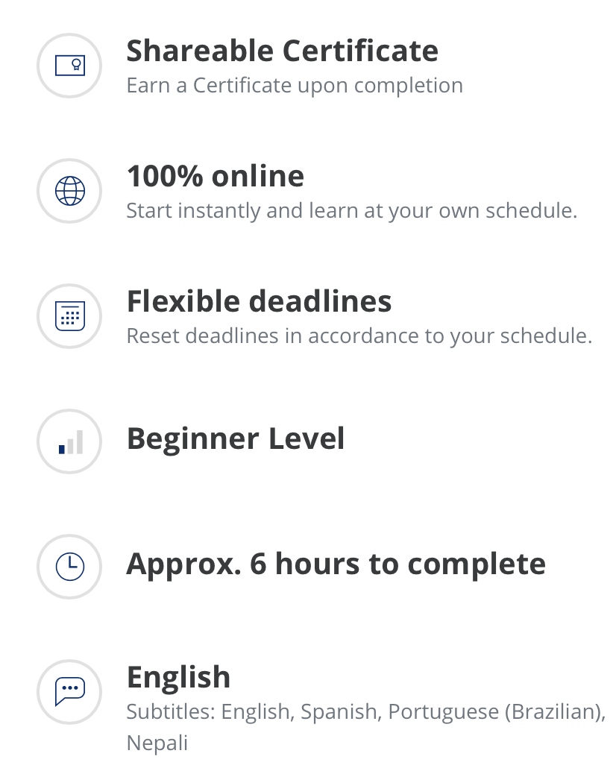
Resources
Notes:
Johns Hopkins University has developed a FREE COVID-19 Contact Tracing online training module on Coursera. The six-hour course should be required for the person who your practice designates as the “internal contact tracer.”

Slide 29
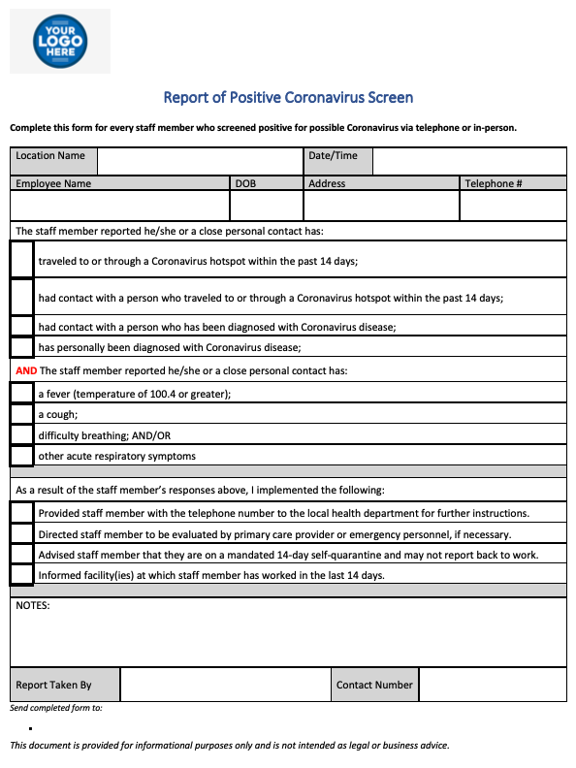
Sample COVID-19+ Report

Slide 30
Resources
JAMA: Building an “Army of Disease Detectives” to Trace COVID-19 Contacts
Forbes: The Features Any Ethical Covid-10 Contact Tracing Effort Should Incorporate
Johns Hopkins University free online contact tracing course
Medical Practice Sample Coronavirus Screen Form
Notes:
I wanted to provide you with several resources that you may find helpful.
Two of the links are helpful articles as you prepare to consider adding a contact tracing program within your practice. The 3rd link is for the Johns Hopkins course we just discussed and the last link is to a Coronavirus screening form that you can download and modify for use in your practice.

Slide 31
Q & A
Notes:
And with that, I’d like to invite you to ask any questions that I may be able to address. Additionally, you’ll find my contact information in the event you’d like to connect.

Slide 32
Contact Information
Brian Ramos, MBA, CMPE
Chief Operating Officer
Capital Anesthesia Partners
 | 202-780-1700
 | bramos@capitalanesthesia.org
 | brianramosmba
 | linkedin.com/in/brianramos

